Slide 1
Part 04: Behaviours

Slide 2
Behaviours
Implement different ways of pathfinding (for example)
Strategy Pattern
Separate the algorithm from the data
Making sure they do everything in order
Command pattern
Replays
AI control
‘Action queue’ in an RTS

Slide 3
Strategy
Create interchangeable, encapsulated, algorithms that perform different functions that are indistinguishable from each other.

Slide 4
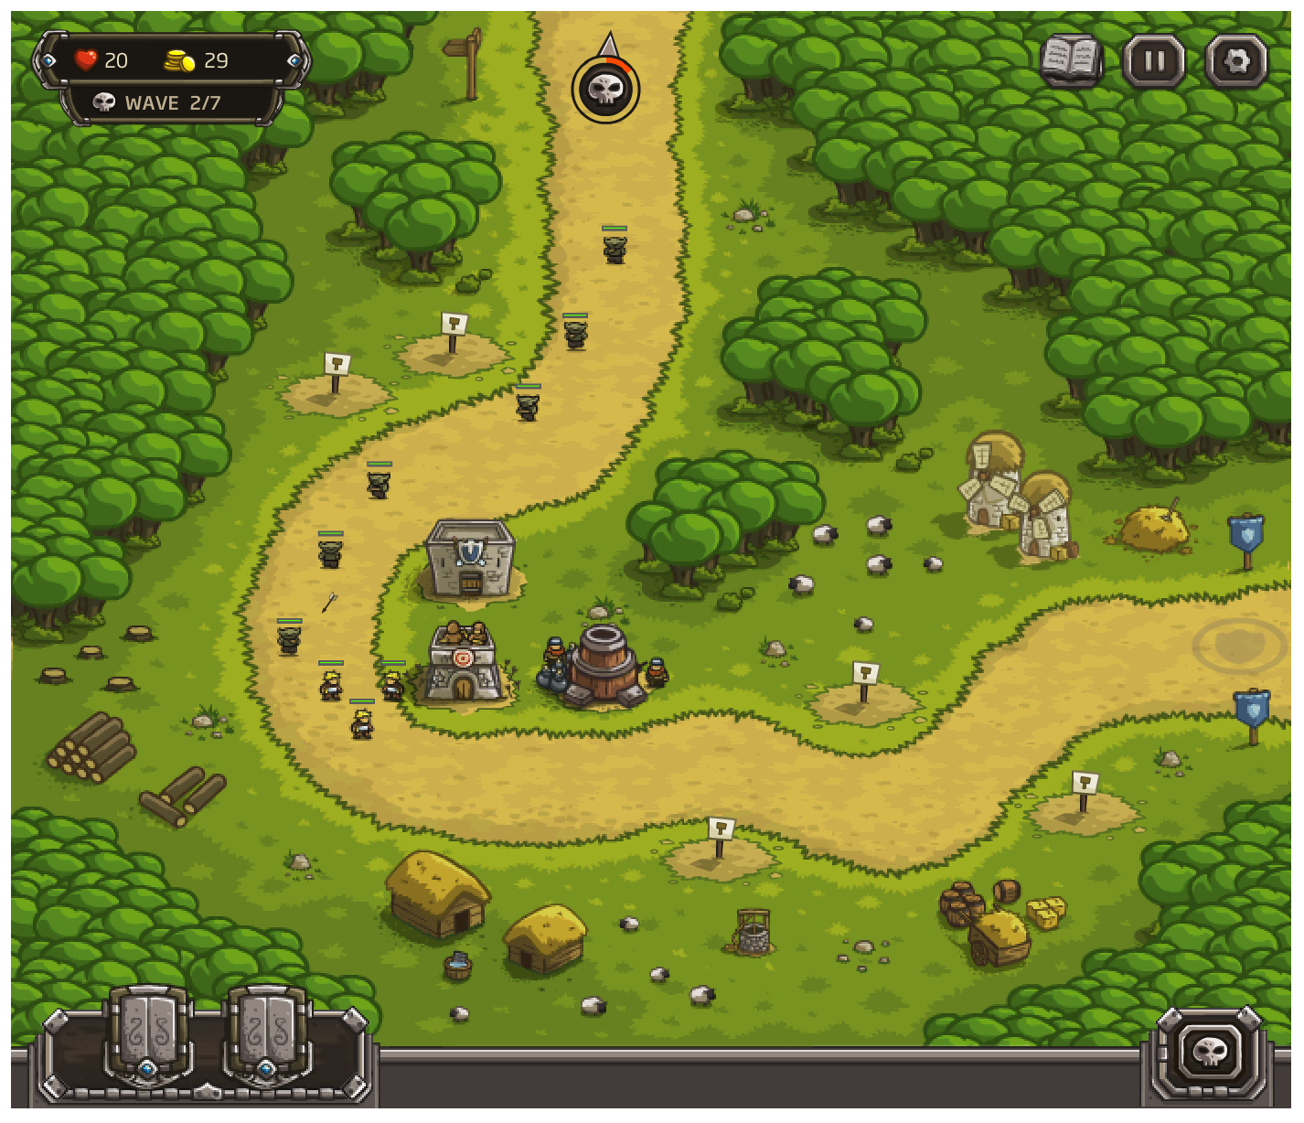


Let’s look at our units
Now we have 2 mobs with different behaviours:
Walking mobs
Spawns
Follows path
Attacks
Flying mobs
Spawns
Flies right to the end point
Waits for 5 seconds
Attacks

Slide 5
Pathfinding
Suppose we want different pathfinding for walkers, fliers and other mobs
InitializeGrid(mGrid); if (walker) { findWalkingPath(); }else if (flier) { findDirectPath(); } return mGrid;
… What happens if we get a different type? (say a runner)

Slide 6
Pathfinding
Suppose we want different pathfinding for walkers, fliers and other mobs
InitializeGrid(mGrid); if (walker) { findWalkingPath(); }else if (flier) { findDirectPath(); } return mGrid;
… neither modular nor extensible! … VERY tempting though

Slide 7
Strategy Pattern pt0
Class GameAreaContext{
}
Keep all shared state in one object
This is flyweight again
Encapsulate the algorithm in other objects that can loaded at run time

Slide 8
Strategy Pattern pt1
Class GameAreaContext{
}
IPathAlgorithm
FindPath(context);
AStarPath
DirectPath
… and then the entity picks the algorithm and passes it to the current game context!

Slide 9

Strategy Pattern pt02
InitializeGrid(mGrid); if (walker) { findWalkingPath(); }else if (flier) { findDirectPath(); } return mGrid;
InitializeGrid(mGrid); IPathFindingAlgorithm algo = mob.getAlgorithm();
algo.findPath(mGrid); return mGrid;

Slide 10
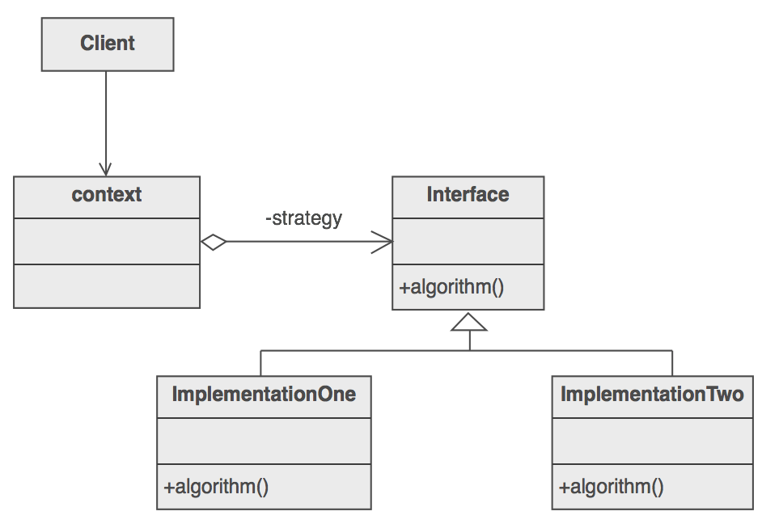
Getting Technical
Identify an algorithm (i.e. a behavior) that the client would prefer to access through a "flex point".
Specify the signature for that algorithm in an interface.
Bury the alternative implementation details in derived classes.
Clients of the algorithm couple themselves to the interface.

Slide 11
Participants
Strategy
This is the interface that is common to all supported algorithms
ConcereteStrategy
Implements an algorithm using the Strategy interface
Context
Configured with a ConcreteStrategy object
Maintains a reference to a Strategy object
Optional: define an interface that lets Strategy access the contexts data

Slide 12
How it works
Strategy and Context interact to implement the chosen algorithm
A context forwards the request from its clients to its strategy
Clients create and pass a ConcreteStrategy object to the context
Afterwhich clients interact with the context exclusively There is often a family of ConcreteStrategy classes for the client to choose

Slide 13
Strategy Pattern revisited
Class GameAreaContext{
}
IPathAlgorithm
FindPath(context);
AStarPath
DirectPath
… and then the entity picks the algorithm and passes it to the current game context!

Slide 14
iPathAlgorithm is the strategy

Slide 15
Strategy Pattern now with interfaces
Class GameAreaContext{
}
IPathAlgorithm
FindPath(context);
AStarPath
DirectPath
… and then the entity picks the algorithm and passes it to the current game context!

Slide 16
iPathAlgorithm is the strategy
AStarPath and DirectPath are the ConcreteStrategies

Slide 17
Strategy Pattern return of the context
Class GameAreaContext{
}
IPathAlgorithm
FindPath(context);
AStarPath
DirectPath
… and then the entity picks the algorithm and passes it to the current game context!

Slide 18
All together now
iPathAlgorithm is the strategy
AStarPath and DirectPath are the ConcreteStrategies
GameAreaContext is the context
Lets look at some code: https://drive.google.com/file/d/1vobPLkxNbJeVtWVP6VfEQ1oshUIIVwve/view

Slide 19
Back to the Example
Flying mob found the path
Now we want it to perform its dance:
Flying mob Spawns
Flies right to the end point
Waits for 5 seconds
Attacks
We will use this to introduce the Command Pattern!

Slide 20
Command
Wrapping method calls in objects since 1985
Command is an object-oriented replacement for callbacks. . . . What?

Slide 21


What does square do? What about triangle? X? O?
What if I told you we could map the buttons to functions that take parameters that determine what happens by whom?
What if I told you we could use this same strategy to let our AIs control the world the way we do…

Slide 22
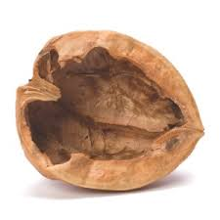
Command in a nutshell
Essentially we are passing methods as arguments → functional much?
We can also pass who acts on the passed method
This allows for all kinds of neat stuff.
Not for nothing this is also the first pattern discussed in Game Programming Patterns...

Slide 23
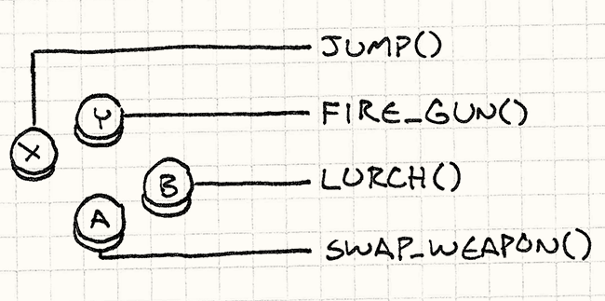
The Motivation
void InputHandler::handleInput() { if (isPressed(BUTTON_X)) jump(); else if (isPressed(BUTTON_Y)) fireGun(); else if (isPressed(BUTTON_A)) swapWeapon(); else if (isPressed(BUTTON_B)) lurchIneffectively(); }
If we do this we can't re-configure the controller.
It is likely we can't control anything else either.

Slide 24
class InputHandler { public: void handleInput(); // Methods to bind commands... private: Command* buttonX_; Command* buttonY_; Command* buttonA_; Command* buttonB_; };
Now we have the command pattern. We can swap out our methods like variables.
If we wanted jump() to be lurch()...
class Command { public: virtual ~Command() {} virtual void execute() = 0; };
class JumpCommand : public Command { public: virtual void execute() { jump(); } }; class FireCommand : public Command { public: virtual void execute() { fireGun(); } };
void InputHandler::handleInput() {
buttonX_ = JumpCommand();
buttonY_ = FireCommad(); if (isPressed(BUTTON_X)) buttonX_->execute(); else if (isPressed(BUTTON_Y)) buttonY_->execute(); else if (isPressed(BUTTON_A)) buttonA_->execute(); else if (isPressed(BUTTON_B)) buttonB_->execute(); }

Slide 25
One Step Further
class Command { public: virtual ~Command() {} virtual void execute(GameActor& actor) = 0; };
By passing in an object that can be acted upon, here it is a player object, we can have our execute() method operate on the actor itself… provided the actor knows what to do:
class JumpCommand : public Command { public: virtual void execute(GameActor& actor) { actor.jump(); } };

Slide 26

Evil AIs playing our games.
Using this same model we can now have our AIs pass in objects to be commanded.
We can also serialize these commands and send them to a server Secretly this is how multiplayer often works.
This is ALSO yet another way to implement an undo feature… more on that in a moment.

Slide 27
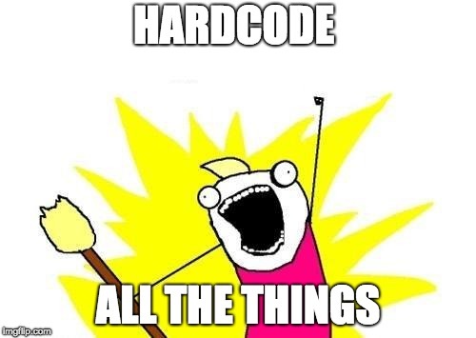

Bad version
On each update:
if ( !_spawned) { SpawnMonster(); _spawned = true; }else if (! NearGoal()) { FlyToGoal(); }else if (! TimerStarted()){ StartTimer(); }else if (TimerFinished()){ Attack(); }
This is UGLY code
Also, this is just a handmade state machine…
It also makes baby Turing cry

Slide 28
Okay Version - finite state machine
FSMs are easy to implement
messy once they scale up, or add different variants
Spawn
Wait
Wait
Fly directly to goal
Spawning done
Near goal

Slide 29
Better Version - Action Sequence
Spawn at (x,y)
Fly direct to (x’,y’)
Wait 5 seconds...
ATTACK!
DONE!
Each of these is a data object inside a Queue<> that fully encapsulates that behaviour

Slide 30
Better Version - The action queue
Spawn at (x,y)
Fly direct to (x’,y’)
Wait 5 seconds...
ATTACK!
DONE!
Fly direct to (x’,y’)
Wait 5 seconds...
ATTACK!
DONE!
Notes:
Spawner queue pops action

Slide 31
Better Version - The action queue
Spawn at (x,y)
Fly direct to (x’,y’)
Wait 5 seconds...
ATTACK!
DONE!
Fly direct to (x’,y’)
Wait 5 seconds...
ATTACK!
DONE!
Wait 5 seconds...
ATTACK!
DONE!
Notes:
Pop fly direct action

Slide 32
Better Version - The action queue
Spawn at (x,y)
Fly direct to (x’,y’)
Wait 5 seconds...
ATTACK!
DONE!
Fly direct to (x’,y’)
Wait 5 seconds...
ATTACK!
DONE!
Wait 5 seconds...
ATTACK!
DONE!
ATTACK!
DONE!
Notes:
Pop attack action

Slide 33
Better Version - The action queue
Spawn at (x,y)
Fly direct to (x’,y’)
Wait 5 seconds...
ATTACK!
DONE!
Fly direct to (x’,y’)
Wait 5 seconds...
ATTACK!
DONE!
Wait 5 seconds...
ATTACK!
DONE!
Now figure out what to do next and refill the action queue with MOAR ACTIONS!
ATTACK!
DONE!
DONE!
Notes:
Pop attack action

Slide 34
Better Version - Action Sequence
Flying monster action queue:
Spawn at (x,y)
Fly direct to (x’,y’)
Wait 5 seconds...
ATTACK!
DONE!
Walking monster action queue:
Spawn at (x,y)
Compute A* path
Use A* path
ATTACK!
DONE!
Mix and match functionality
Easy to implement
Used in a lot of games (RTSs, the Sims, etc)

Slide 35
The basic idea…
If each of these entries is a function call...
Flying monster action queue:
spawn (bird, x,y)
move (bird, x’,y’)
wait (bird,5)
attack (bird)
DONE!
move(actor, x,y) : command{ prevX = x; prevY = y; actor.move(x,y);
}
Current

Slide 36
Command Pattern
Split up behaviour logic into steps
Each step is its own class
Create a queue of commands
On each frame:
Let only the first command run its logic
Ask the first command if it is done
If done, pop it and start the next one
This also shows up anywhere you have a sequence of things that need to take a while but must run in sequence
Also useful for encapsulating actions that game actors can take.

Slide 37
Part 04: Behaviours Summary
Strategy
When you have multiple variants of the same behaviour, don’t use if/else statements!
Encapsulate each variant in a class and switch them at runtime
Command
Encapsulate small behaviours inside classes
Instead of hard coding a state machine, use a Queue<> of those commands
The head of the queue is the only one that actually runs
Then when it’s done, pop and move to the next one

